Slide 1
Reinforcement Learning and Pals
D Ellis Hershkowitz

Slide 2


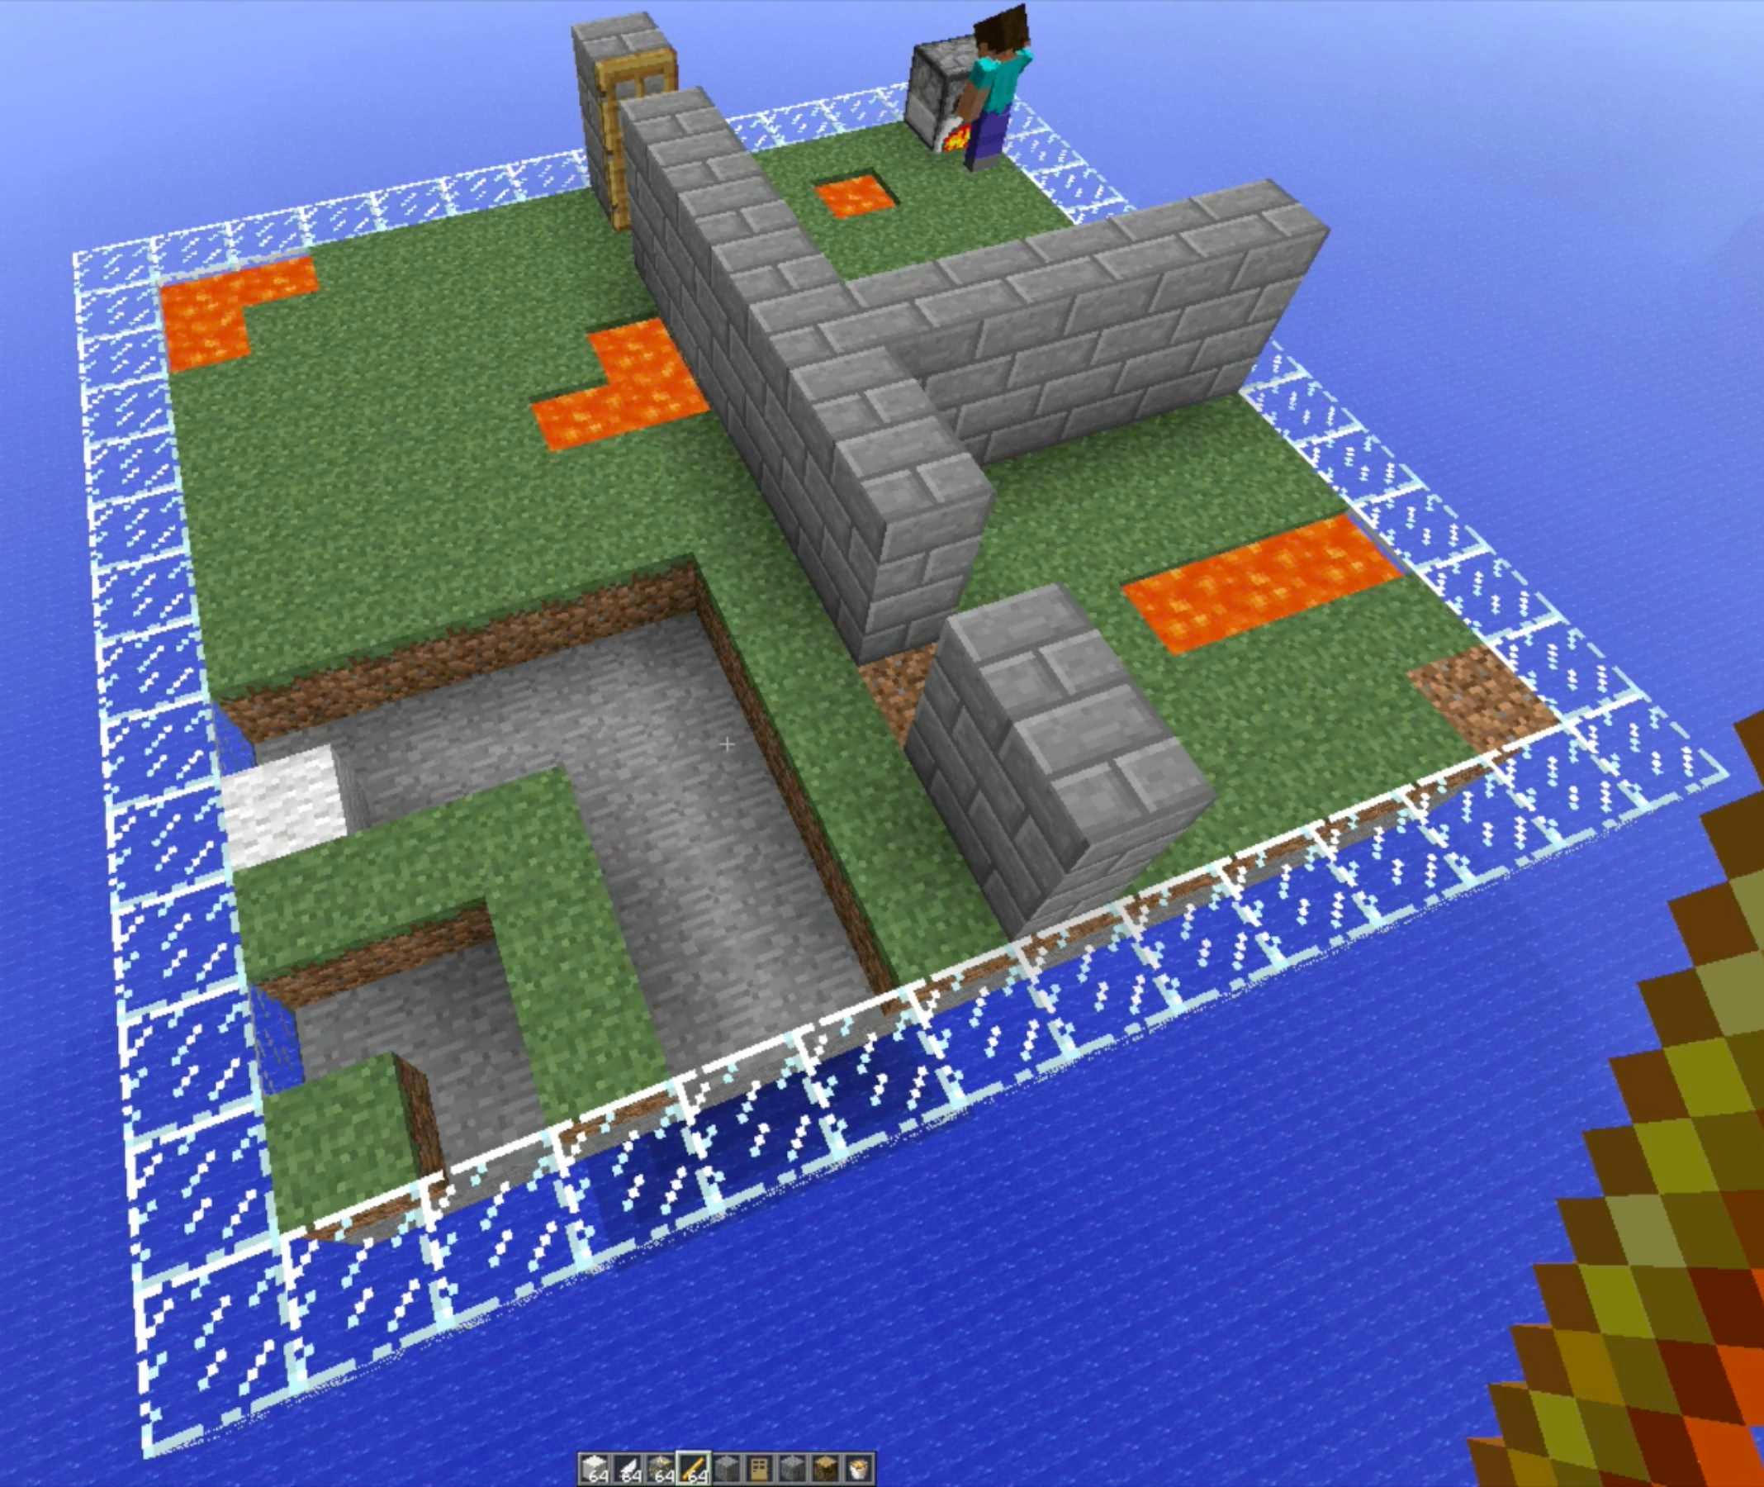
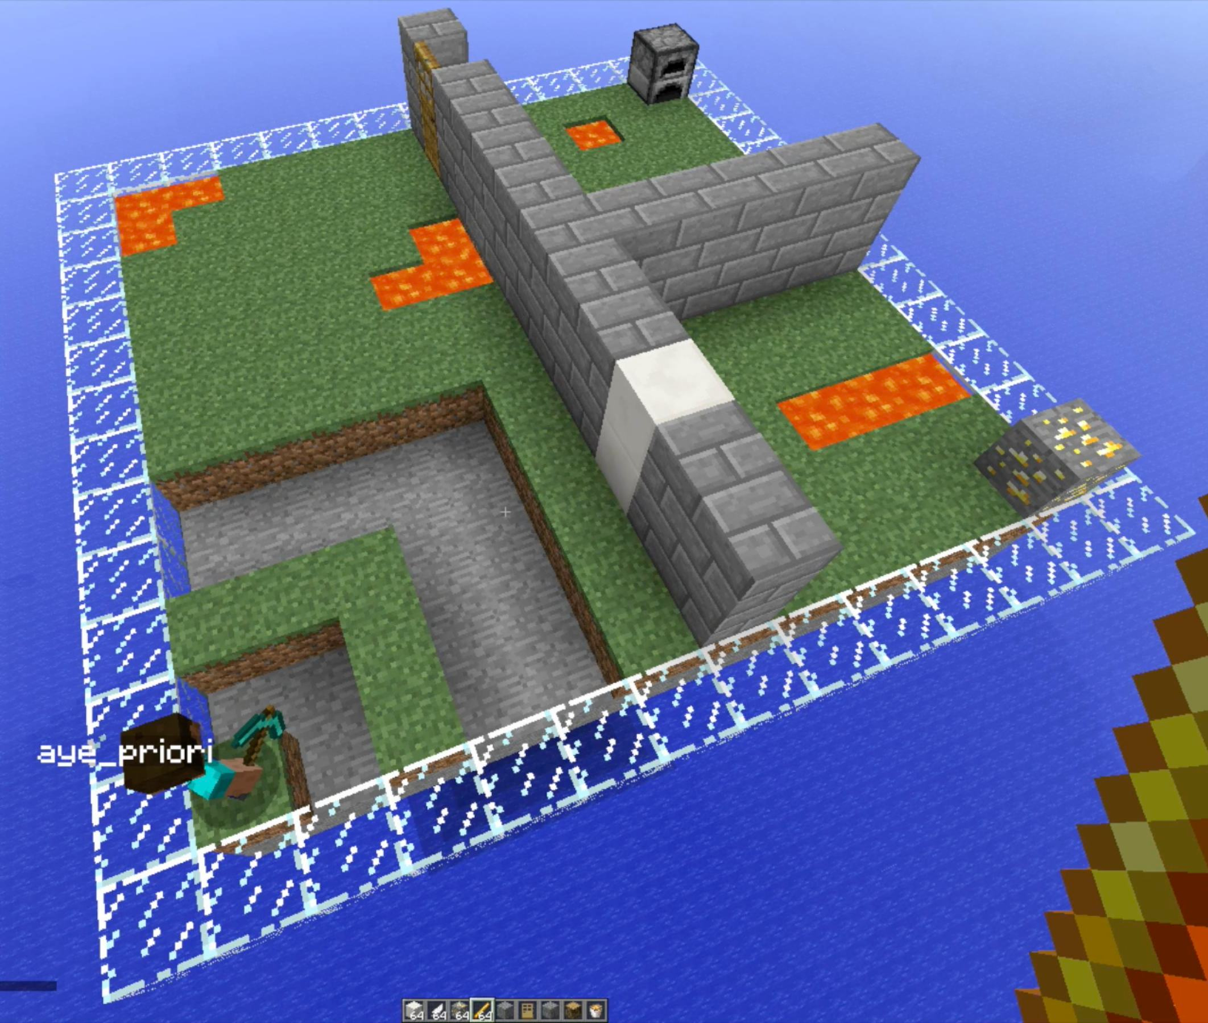
Motivations
?
Move
Destroy Block
Smelt

Slide 3
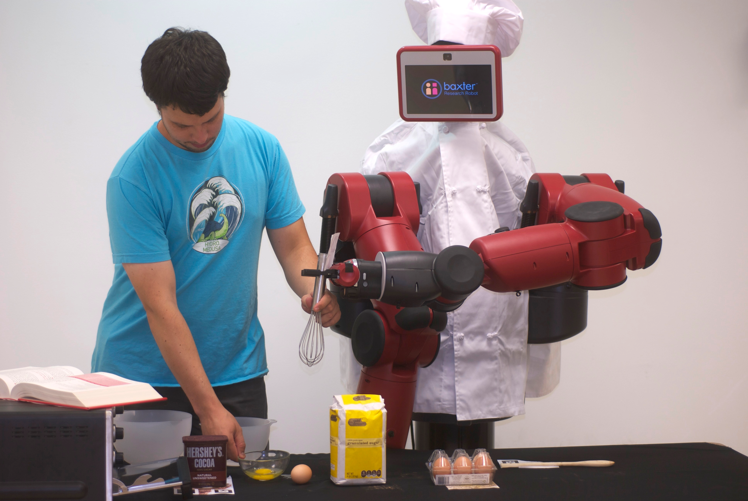
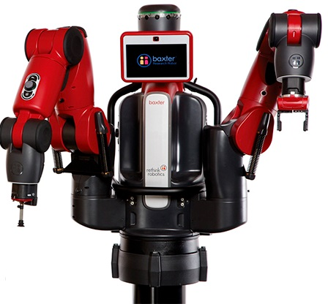

Motivations
?
Motor actuations
Put ingredient in container
Put object A in place B

Slide 4
Transition Dynamics
Solving problems requires understanding how one’s actions affect the world around oneself (transition dynamics).
Often these are obfuscated and so we can’t hope to solve our planning problems.

Slide 5
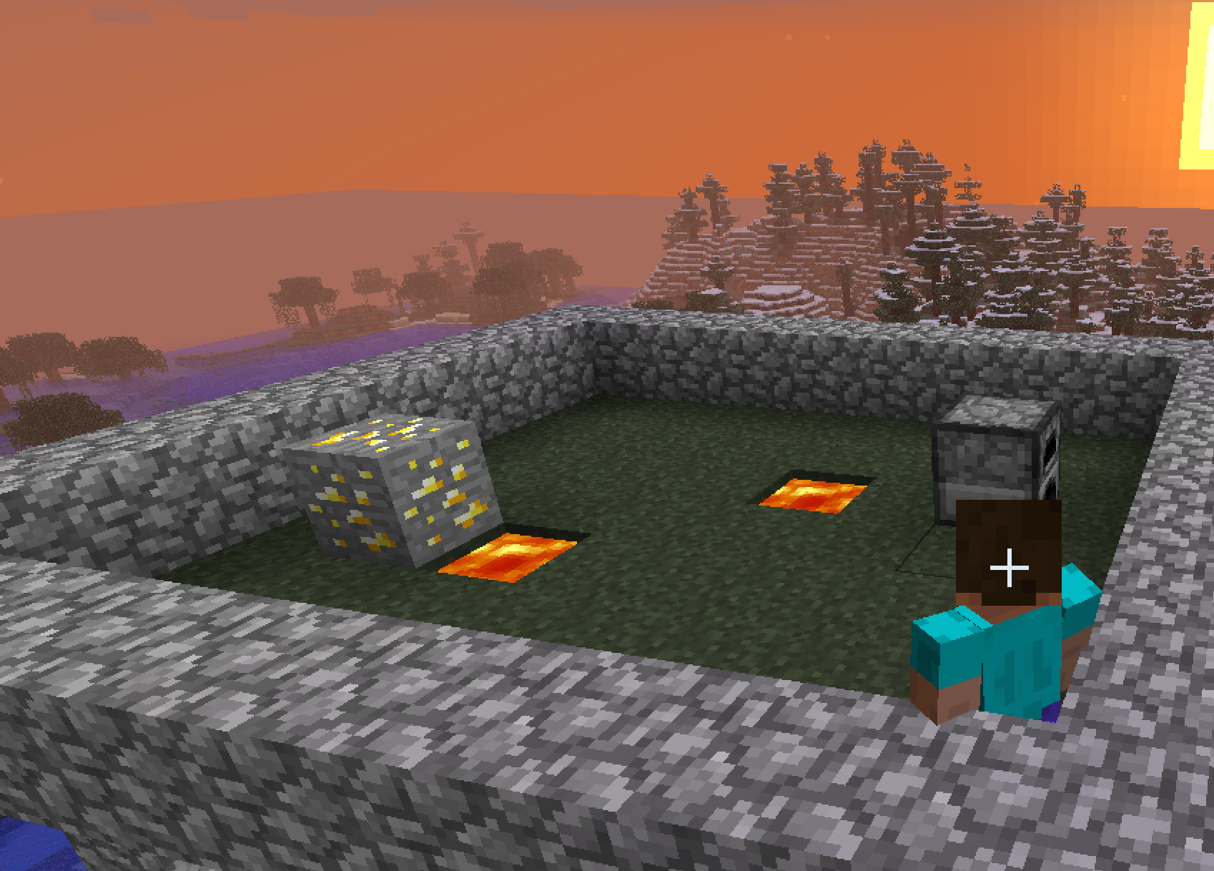
Goal
Learn complex transition dynamics in a family of large state-space MDPs.
Minecraft
Robots

Slide 6
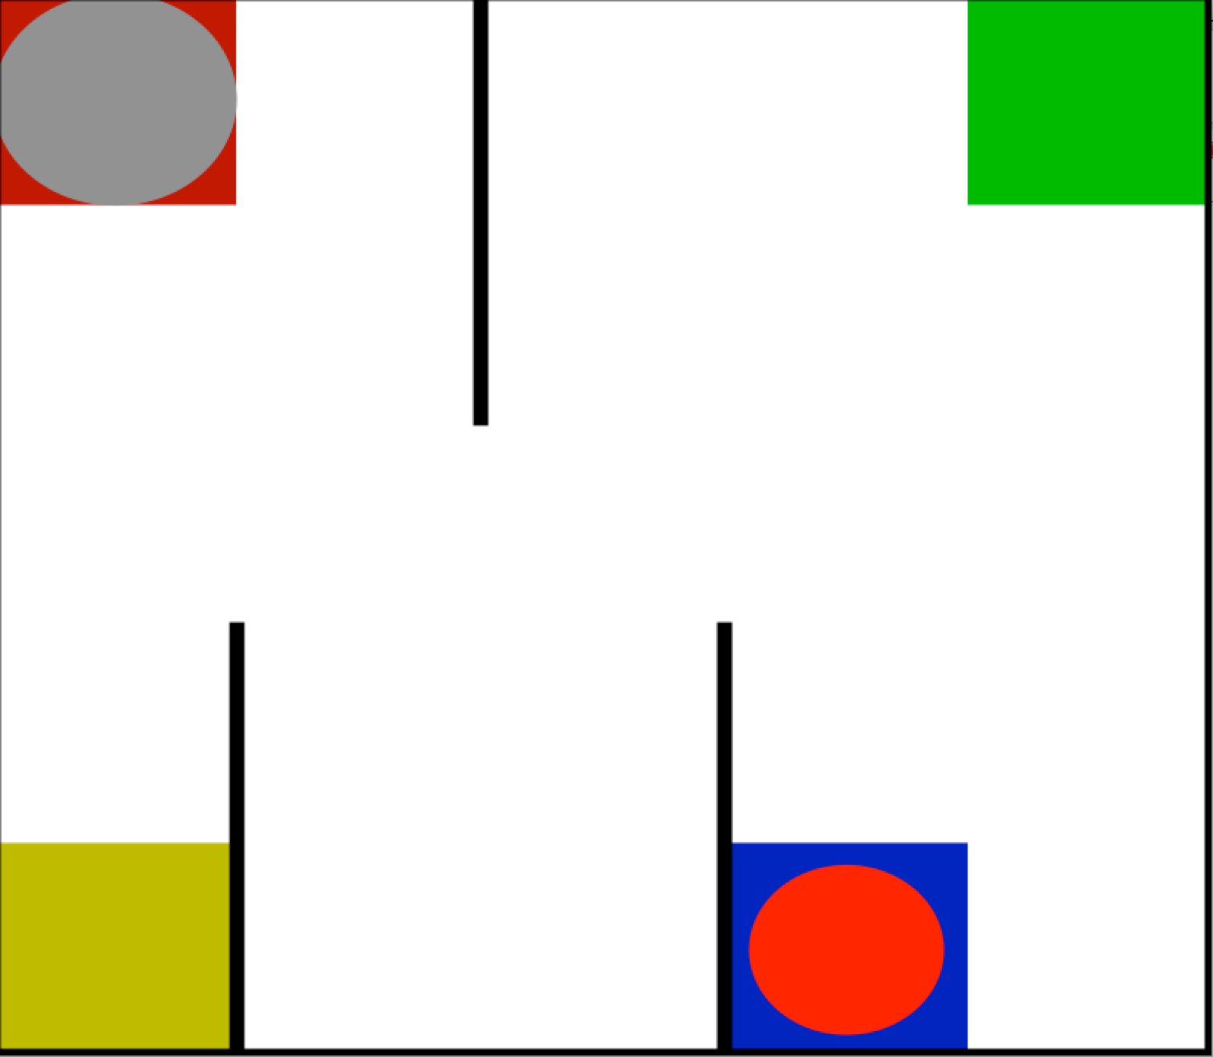
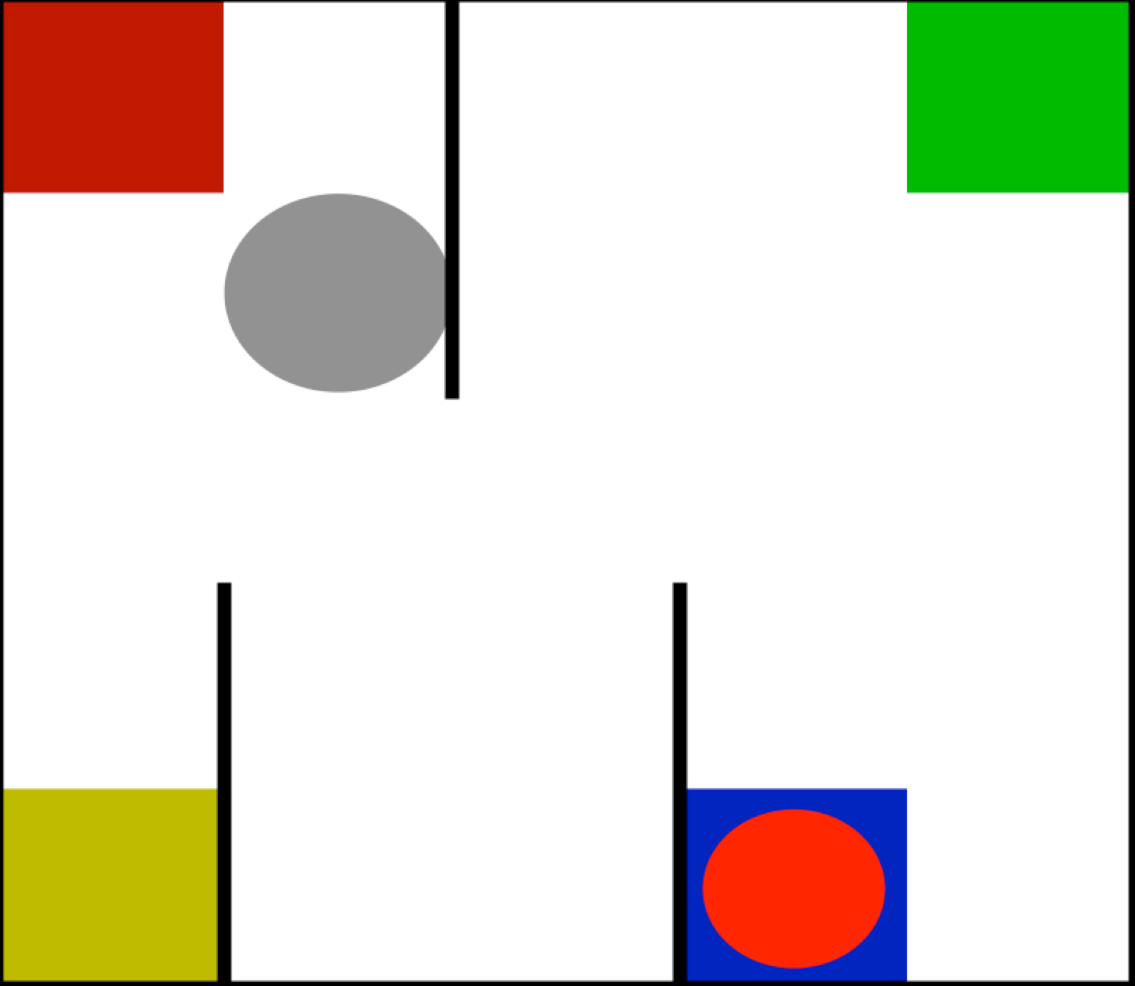
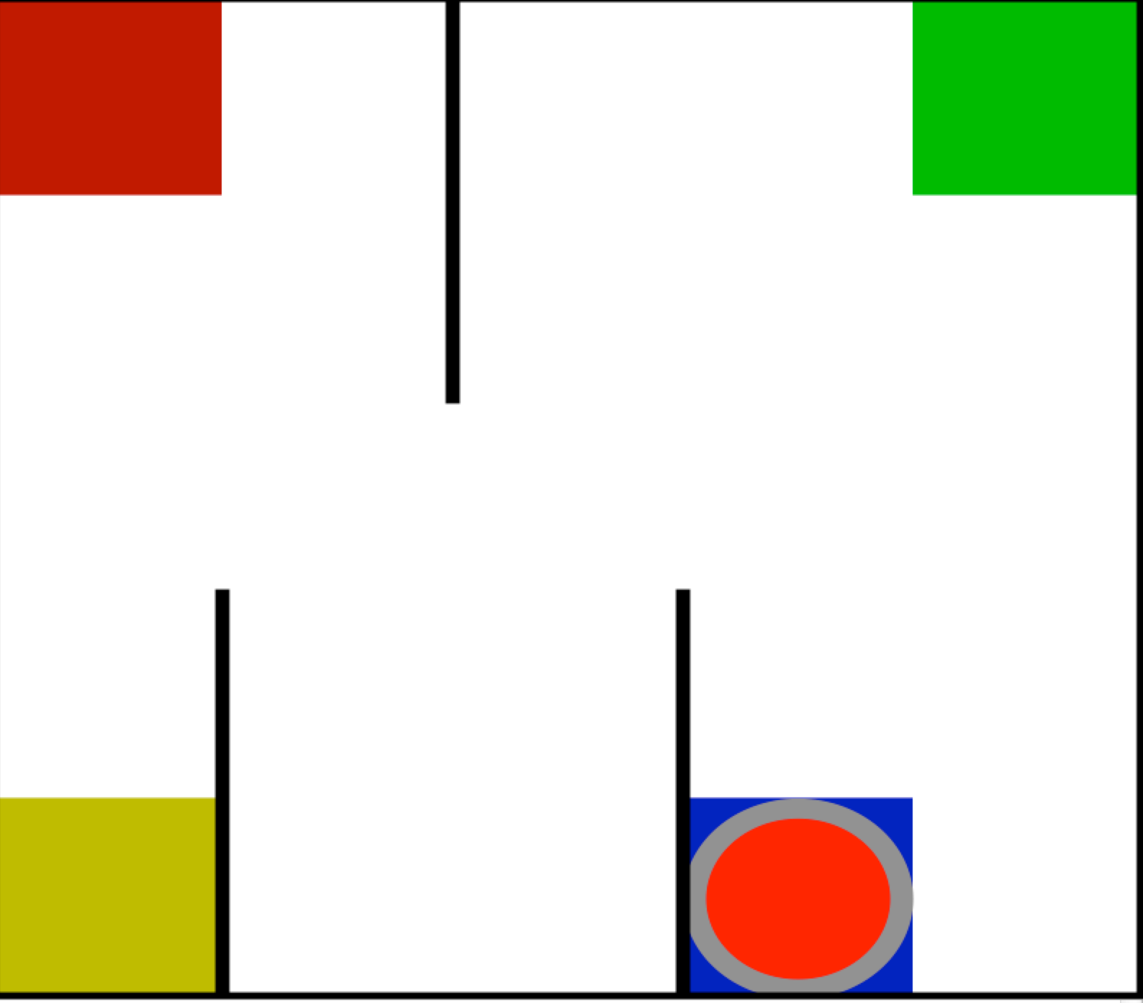

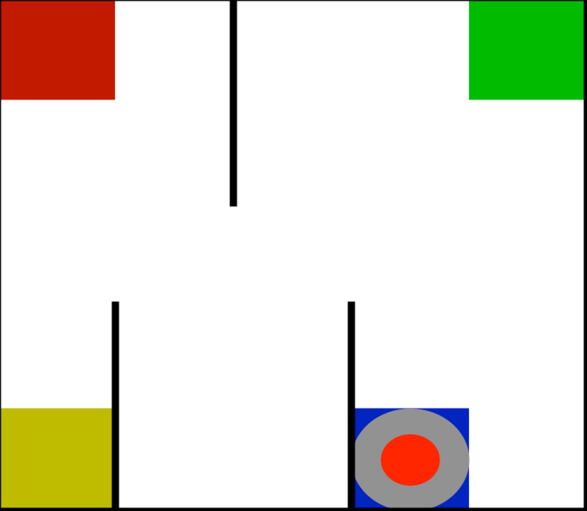
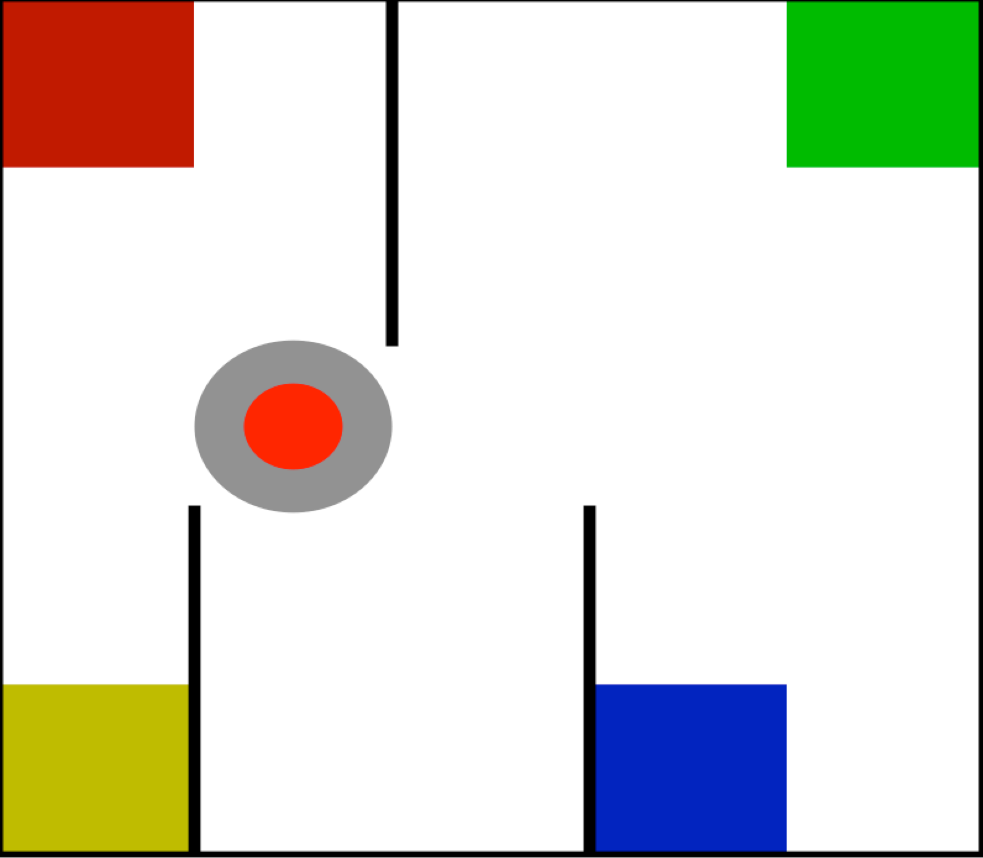

Taxi Domain

Slide 7
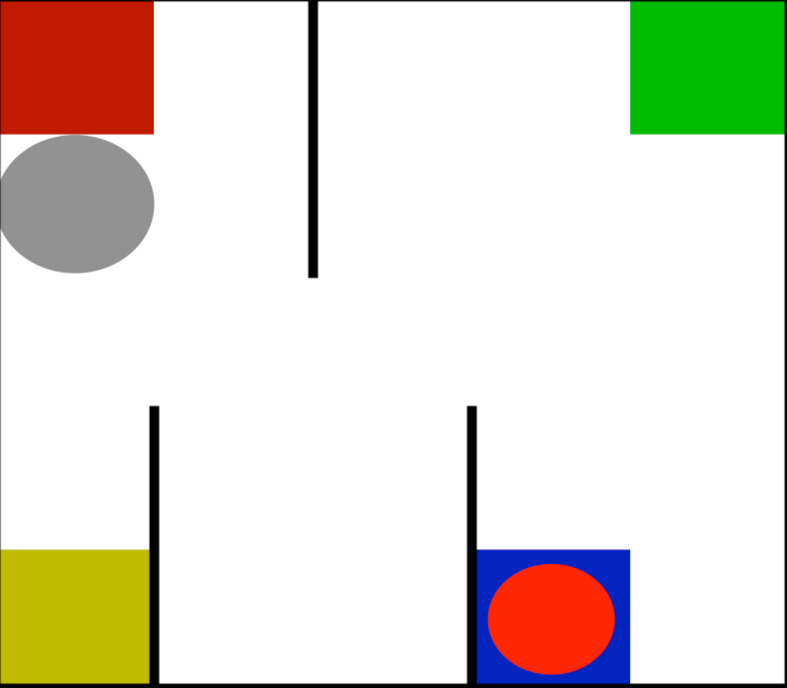
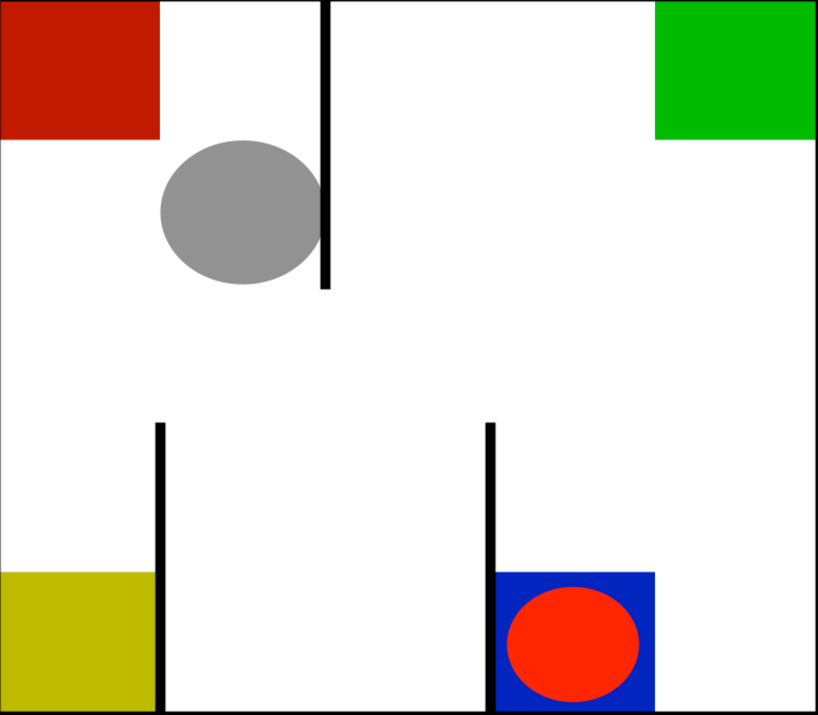
Markov Decision Processes (MDPs)
An MDP is a five tuple of:
1. States (some terminal)
3. Transition Dynamics
+ east =
2. Actions
4. Reward Function
North, east, south, west, pickup, drop off
(uniform negative)
5. Discount Factor

Slide 8
RMAX
Input: (state, actions, resulting state) tuples.
Output: transition dynamics.
Algorithm idea: remember what actions landed you where for each state. Hallucinate amazing states if transition dynamics not known.

Slide 9
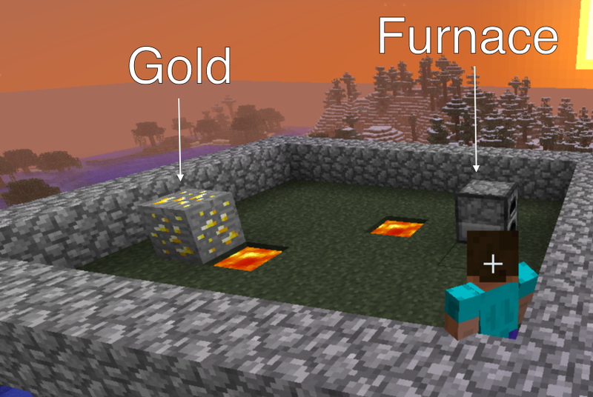
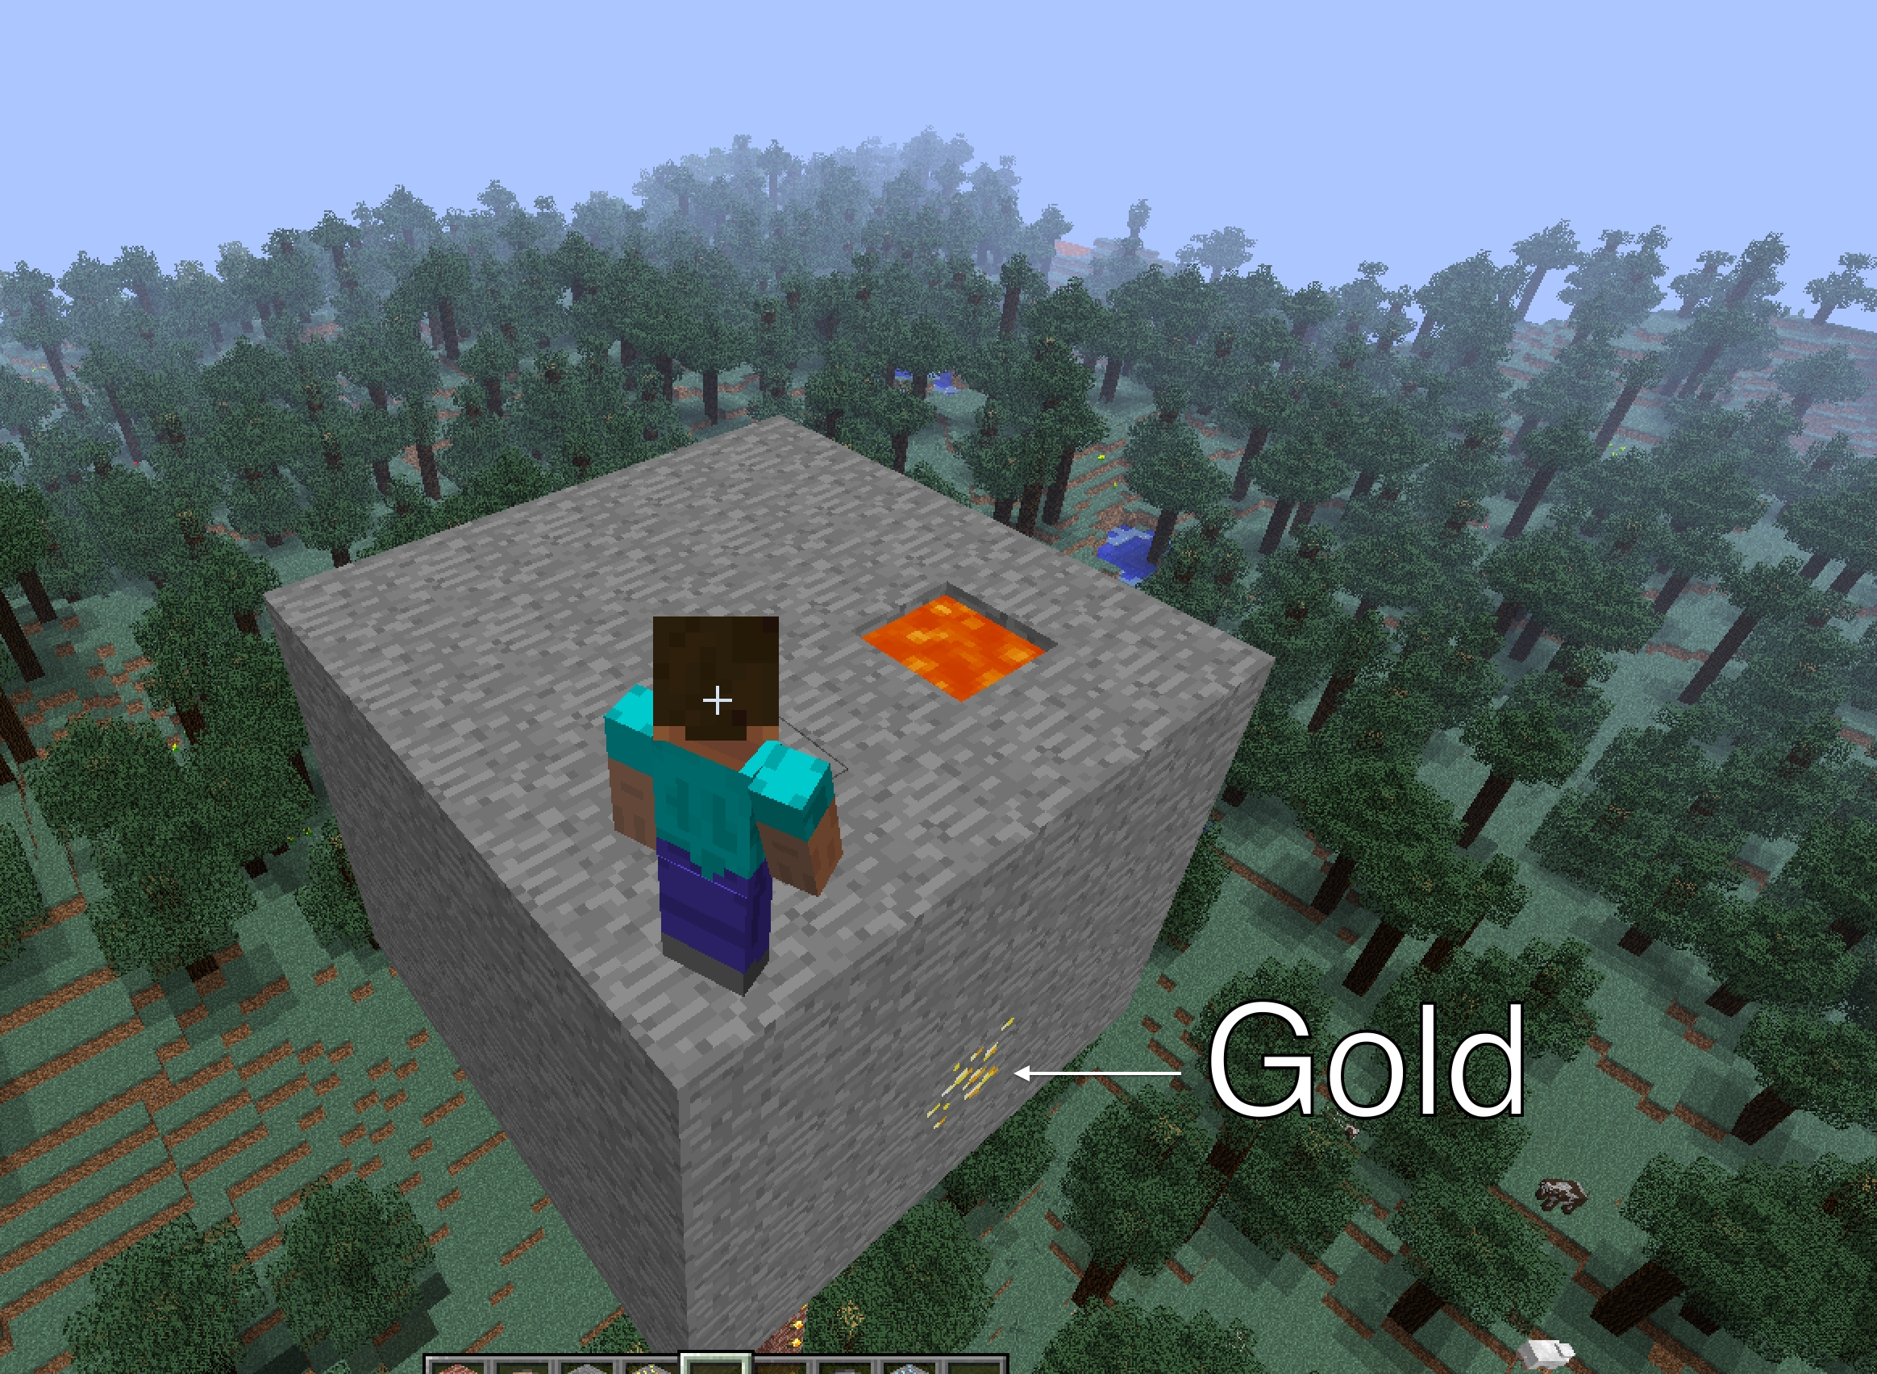
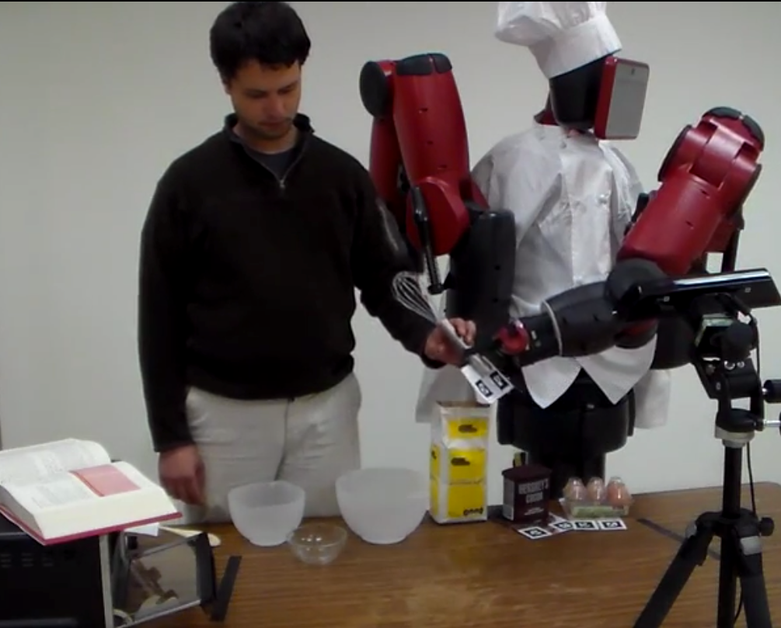
Object-Oriented Thinking
A natural object-oriented, exploitable structure to problems, think:
Minecraft
Robots

Slide 10
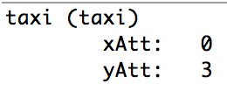
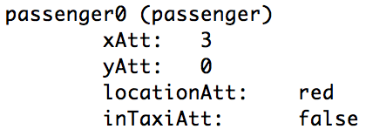
Object-Oriented MDPs (OO-MDPs)
An OO-MDP specifies object classes each of which have attributes that range over some domain.
E.g. taxi (xAtt, yAtt), passenger (xAtt, yAtt, locationAtt, inTaxiAtt)
An OO-MDP state is defined by instantiations of these objects.
An OO-MDP also defines predicates over its states.
E.g. wallToNorthOfTaxi, wallToSouthOfTaxi, passengerInTaxi etc.

Slide 11
What now?
Have nice OO formulations of problems in OOMDPs.
RMAX doesn’t leverage OOMDPs.
We want to leverage OO thinking for large problems.
Minecraft
Robots

Slide 12
DOORMAX
OOMDP take on RMAX.
Input: (state, action and resulting state) triples and PFs.
Output: transition dynamics.
A Knows-What-It-Knows (KWIK) algorithm.

Slide 13
DOORMAX Lingo
Conditions
Xor of conditions
Wall to west
110 xor 010 = *10
000100
Effects
Matching of conditions
**0 matches 101
**0 does not match 100
Predictions

Slide 14

DOORMAX Learning
Given a state, an action and a resulting state:
If a failure condition, store condition for action and return.
East->
Hypothesize all possible effects.
For each hypothesized effect:
(000100)
If there is no prediction that predicts the effect instantiate one.
Knowledge of East
Pred: Add 1 to Agent X to 0 on (101011)
Pred: Assign 0 to Agent X on (000100)
Pred: Assign 1 to Agent X on (000100)
Failure Conditions: (010000), (111000)
Knowledge of East
Pred: Add 1 to Agent X on (*0****)
Pred: Assign 0 to Agent X on (000100)
Pred: Assign 1 to Agent X on (000100)
Failure Conditions: (010000), (111000)
Knowledge of East
Pred: Add 1 to Agent X to 0
on (101011)xor(000100) = (*0****)
Pred: Assign 0 to Agent X on (000100)
Pred: Assign 1 to Agent X on (000100)
Failure Conditions: (010000), (111000)
Knowledge of East
Pred: Add 1 to Agent X on (*0****)
Failure Conditions: (010000), (111000)
Knowledge of East
Pred: Add 1 to Agent X to 0 on (101011)
Pred: Assign 0 to Agent X on (000100)
Failure Conditions: (010000), (111000)
If there is a prediction, update its condition.
Rule out contradictory effect types (overlapping conditions or more than k of an effect type for an action).
Assign 1 to Agent x
Add 1 to Agent x

Slide 15
DOORMAX Prediction
Given a state and action:
If failure condition for the action, predict current state.
(000100)
else pool the effects of all predictions whose conditions match the current state into a pool of effects.
If any effects contradict or pool is empty, return don’t know.
Failure Conditions: (none)
else return the state that results from applying all effects.
Assign Agent x to 1
Add 1 to Agent x

Slide 16
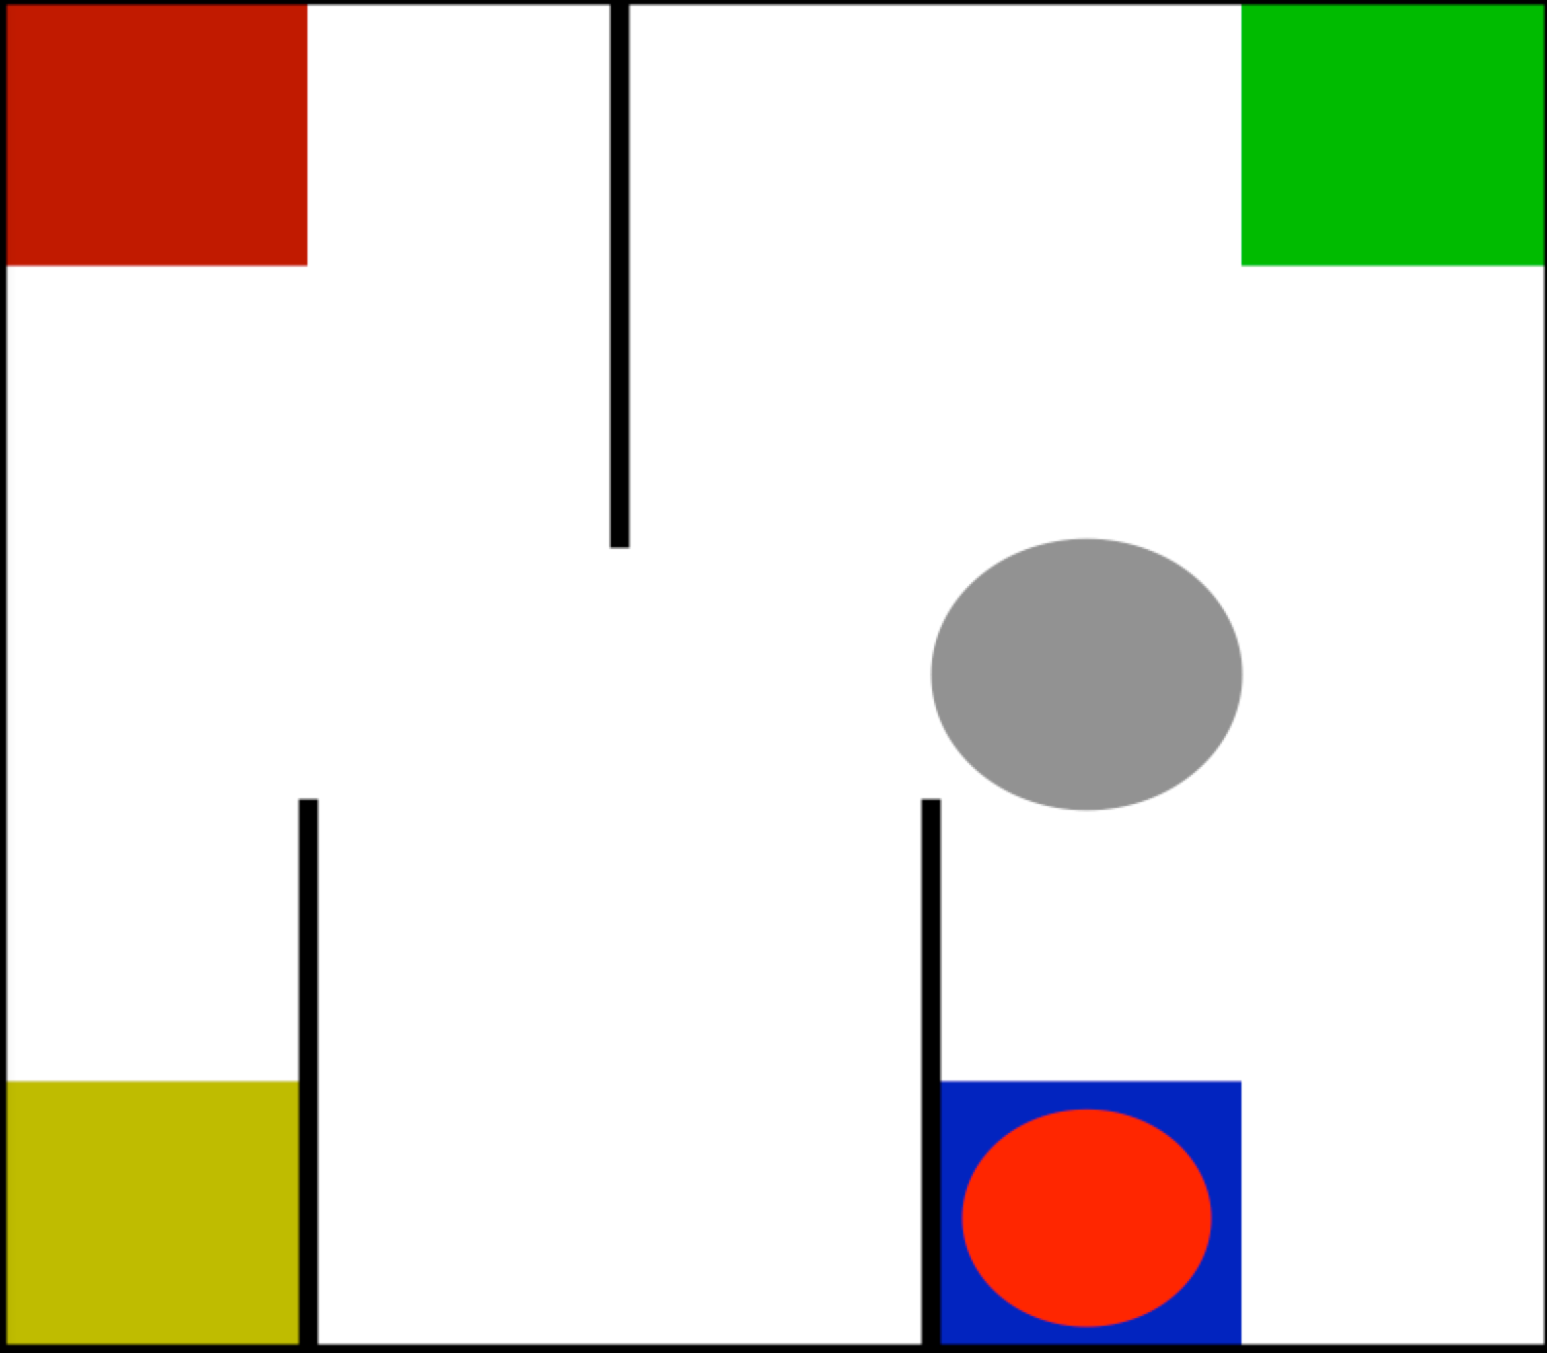
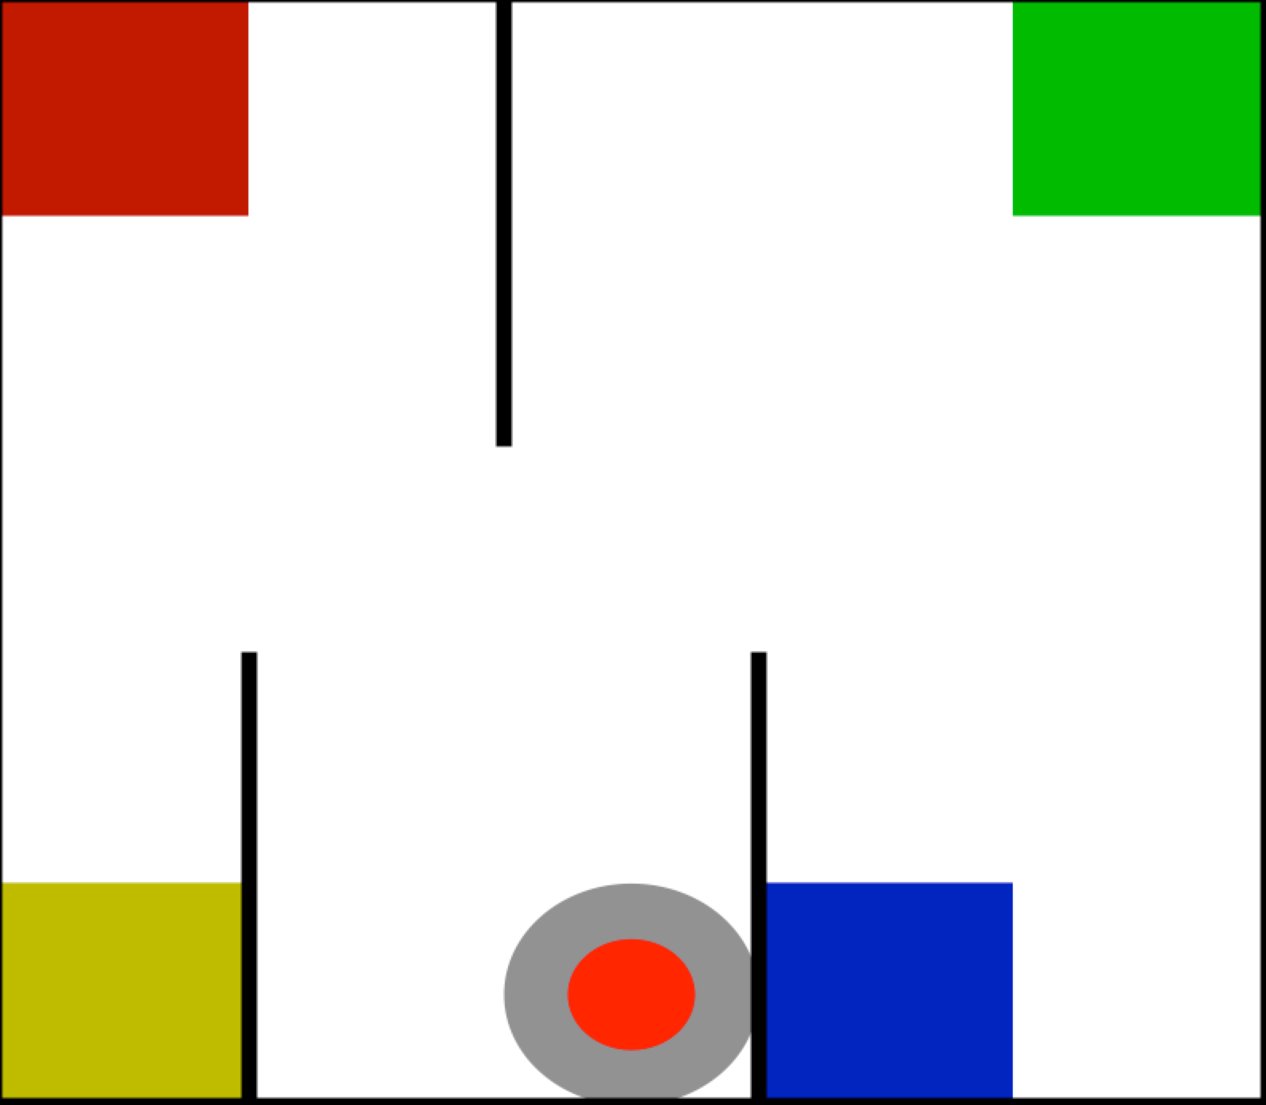
DOORMAX Problem(1/2)
Suppose taxi has moved around but hasn’t encountered the passenger much
Failure Conditions: (none)

Slide 17
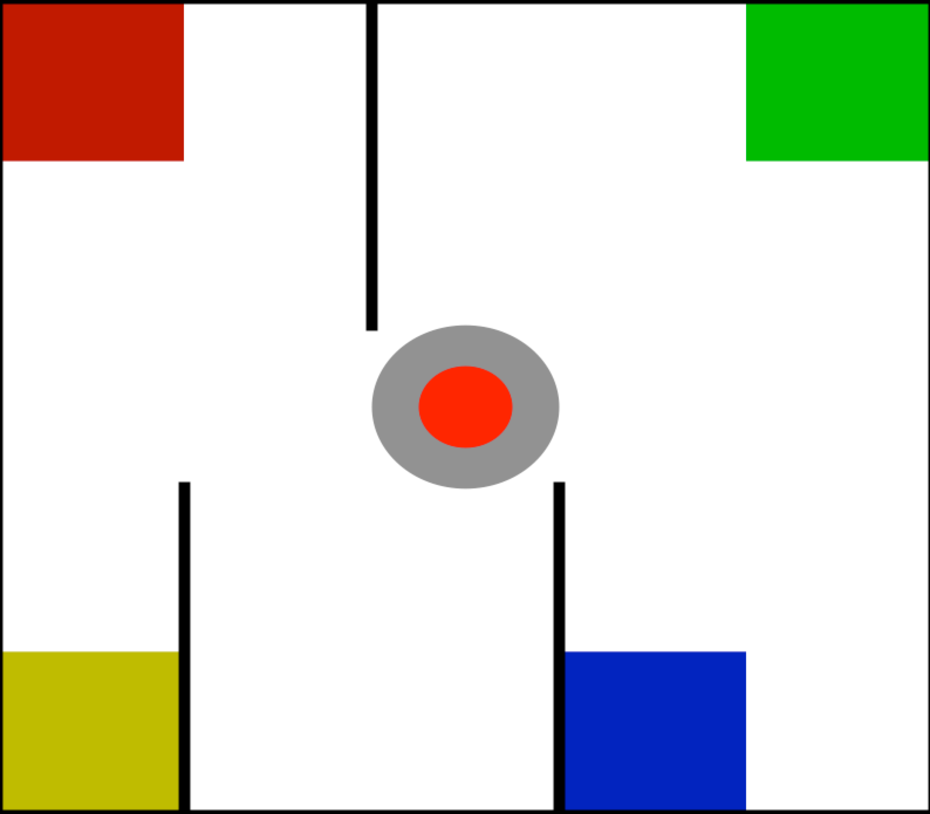
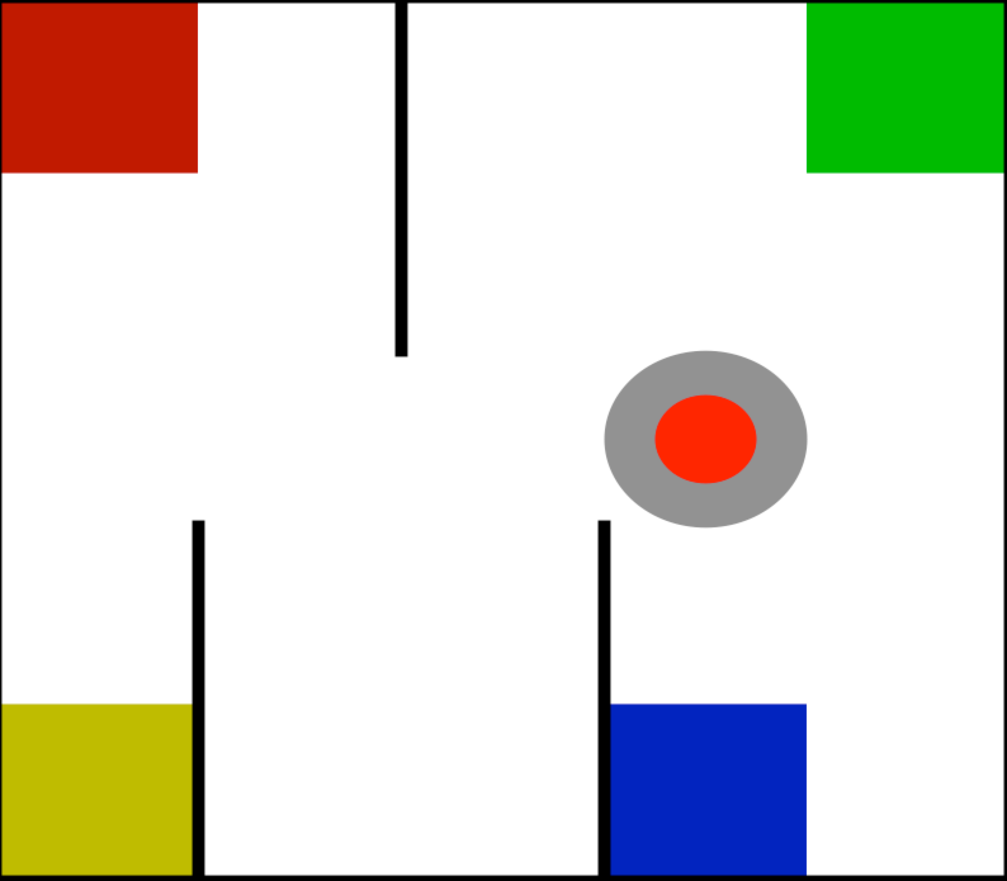
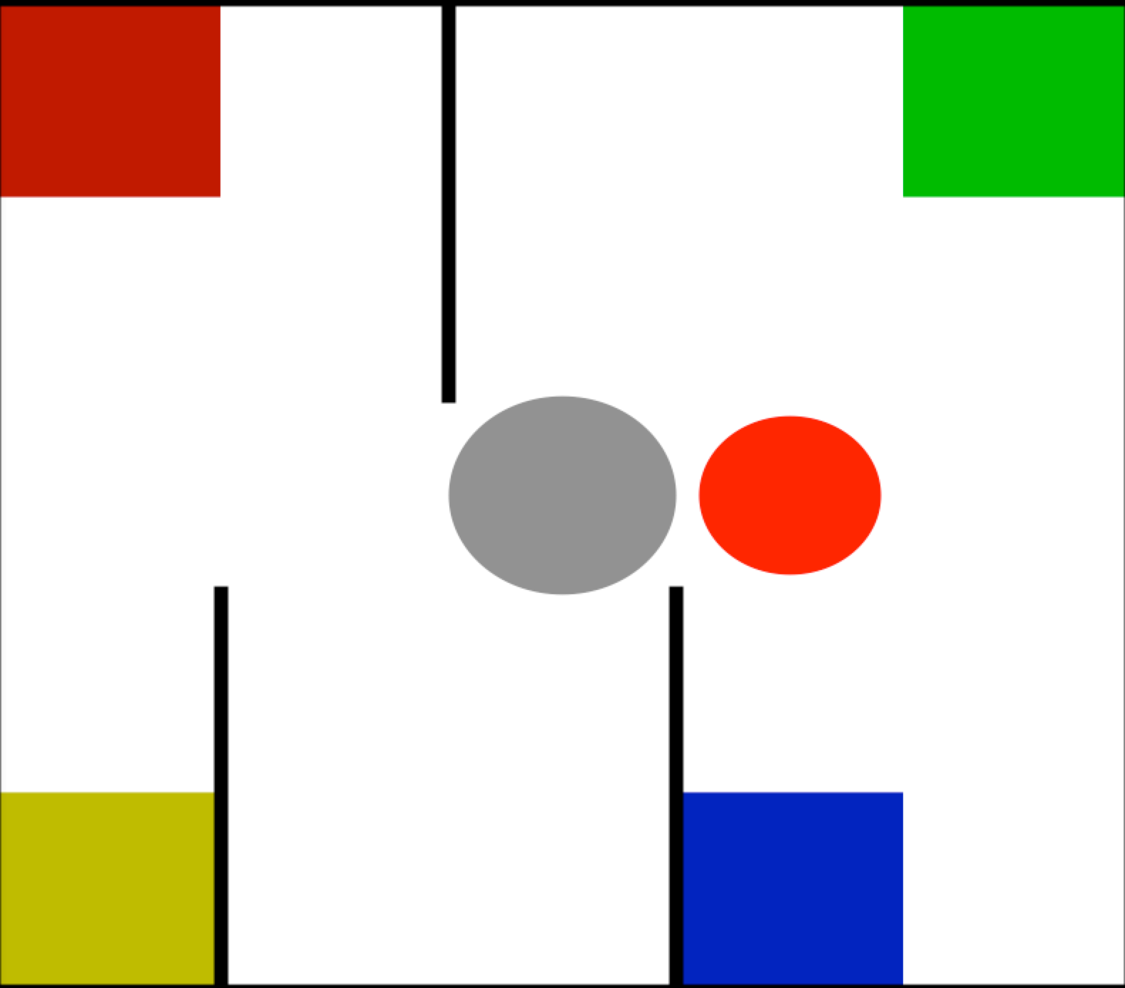
DOORMAX Problem(2/2)
Consider the following scenario:
(Wanted)
Passenger in taxi
(000011)
Taxi at passenger
a
Predicted Effect: subtract 1 from agent’s X
(Predicted)
Failure Conditions: (none)

Slide 18
DOORMAX Solutions (1/2)
Store individual pools and failure conditions for each attribute.
Return don’t know if a pool that is both empty and for which the corresponding action is not a failure condition.
Predicted Effect: subtract 1 from agent’s X
a
???

Slide 19
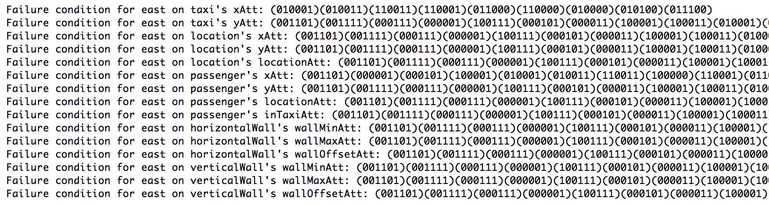
DOORMAX Solutions (2/2)
End result is a prediction pool for each attribute — we return “don’t know” if there is a pool that is both empty and for which the action is not a known failure condition on the attribute.
Effect: subtract 1 from agent’s X
Effect: subtract 1 from agent’s Y

Slide 20
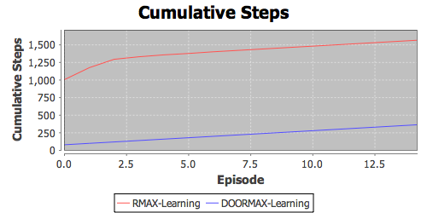
DOORMAX Results

Slide 21
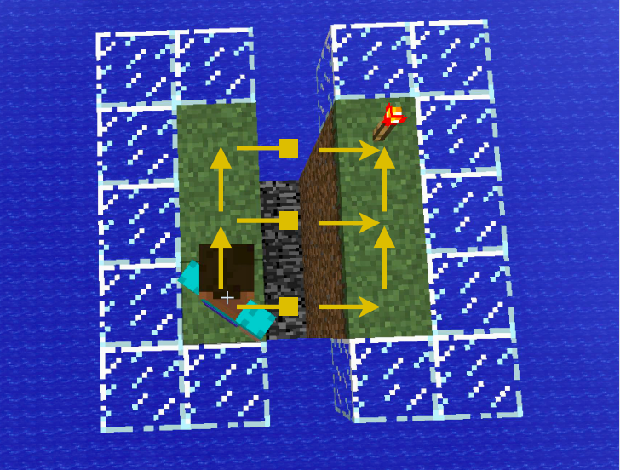
What about Minecraft?
Predictions for Move
Add 1 to Agent Y on condition1
???
Y
Add 1 to Agent X on condition1
X

Slide 22
We Need PFs
If only we had the right propositional function:
Predictions for Move
Add 1 to Agent Y if facingNorth
Add 1 to Agent Y
Y
Add 1 to Agent X if facingSouth
Add 1 to Agent X
X

Slide 23
Specifying PFs
Too many propositional functions.
AgentLookingAtWall
AgentInMidAir
AgentCanJump
HurdleInfrontOfAgent
TrenchInFrontOfAgent
AgentInLava
AgentCanWalk

Slide 24
We Need PFs
Complex transition dynamics require many hard to specify PFs.
Minecraft
Robots
Wouldn’t it be great if we could learn these PFs?…

Slide 25
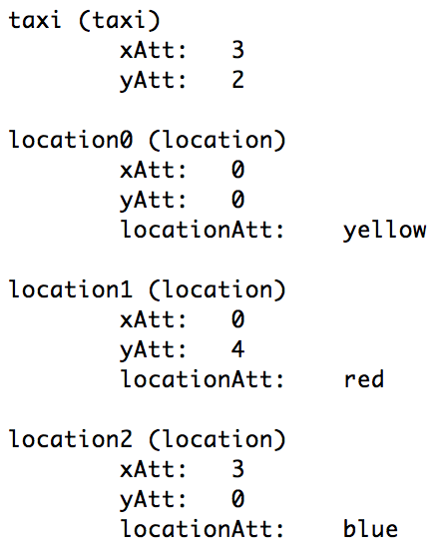
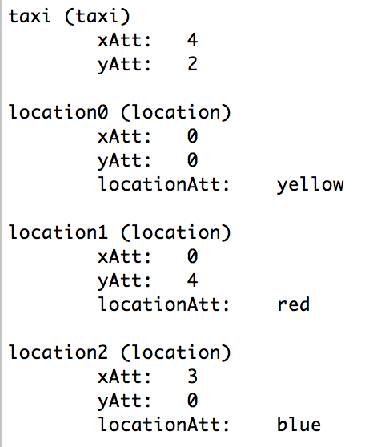
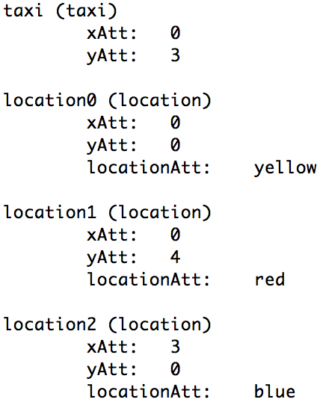
Future Work on Learning PFs
Rather than strictly learn exact conditions, why not use supervised learning?
East affects agent X: S1, S2
North affects agent Y: S1, S37
else pool the effects of all predictions whose conditions are similar to the current state (via classification).
else pool the effects of all predictions whose conditions match the current state into a pool of effects.

Slide 26
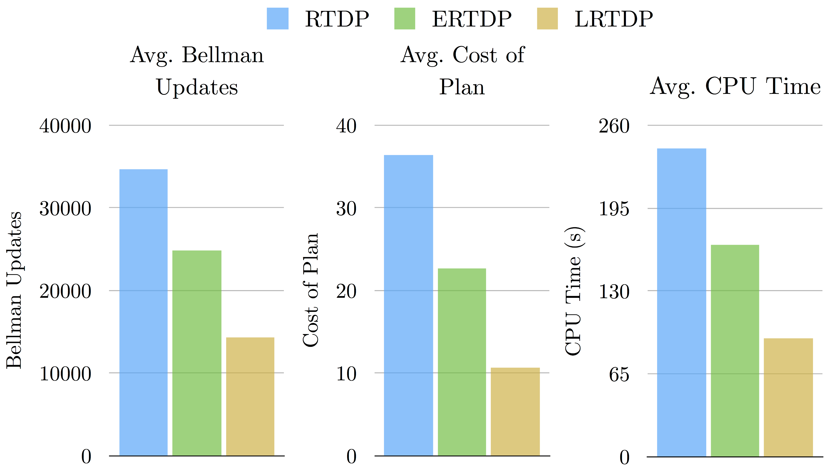
Learning PFs for Affordances
Earlier work on limiting large state-spaces using propositional functions relevant to .
Correspondence between PFs that indicate action optimality and transition dynamics is good news!

Slide 27
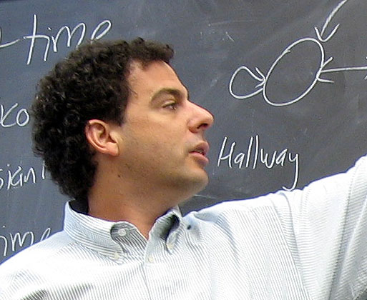
Scaffolding

Slide 28
Questions and Comments

